Slide 1
Design-phase 2
part1

Slide 2




Database Management Systems
Module 16: Relational Database Design/1
SWAYAM: NPTEL-NOC MOOCs Instructor: Prof. P P Das, IIT Kharagpur. Jan-Apr, 2018
Partha Pratim Das
Department of Computer Science and Engineering Indian Institute of Technology, Kharagpur
ppd@cse.iitkgp.ernet.in
Srijoni Majumdar Himadri B G S Bhuyan Gurunath Reddy M
Database System Concepts, 6th Ed.
©Silberschatz, Korth and Sudarshan www.db-book.com

Slide 3
Week 03 Recap
PPD
SWAYAM: NPTEL-NOC MOOCs Instructor: Prof. P P Das, IIT Kharagpur. Jan-Apr, 2018
Module 11: Advanced SQL
Accessing SQL From a Programming Language
Functions and Procedural Constructs
Triggers
Module 12: Formal Relational Query Languages
Relational Algebra
Tuple Relational Calculus (Overview only)
Domain Relational Calculus (Overview only)
Equivalence of Algebra and Calculus
Module 13: Entity-Relationship Model/1
Design Process
E-R Model
Module 14: Entity-Relationship Model/2
E-R Diagram
E-R Model to Relational Schema
Module 15: Entity-Relationship Model/3
Extended E-R Features
Design Issues

Slide 4
Module Objectives
PPD
SWAYAM: NPTEL-NOC MOOCs Instructor: Prof. P P Das, IIT Kharagpur. Jan-Apr, 2018
To identify the features of good relational design
To familiarize with the First Normal Form
To Introduce Functional Dependencies

Slide 5
Module Outline
PPD
SWAYAM: NPTEL-NOC MOOCs Instructor: Prof. P P Das, IIT Kharagpur. Jan-Apr, 2018
Features of Good Relational Design
Atomic Domains and First Normal Form
Functional Dependencies

Slide 6
PPD
Features of Good Relational Design
Atomic Domains and First Normal Form
Functional Dependencies
SWAYAM: NPTEL-NOC MOOCs Instructor: Prof. P P Das, IIT Kharagpur. Jan-Apr, 2018
FEATURES OF GOOD RELATIONAL DESIGN

Slide 7
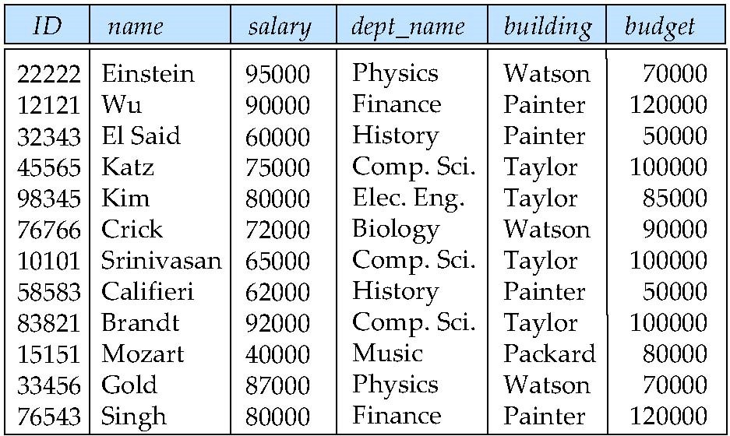
Combine Schemas?
SWAYAM: NPTEL-NOC MOOCs Instructor: Prof. P P Das, IIT Kharagpur. Jan-Apr, 2018
Suppose we combine instructor and department into inst_dept
(No connection to relationship set inst_dept)
Result is possible repetition of information (building and budget against dept_name)

Slide 8
A Combined Schema Without Repetition
SWAYAM: NPTEL-NOC MOOCs Instructor: Prof. P P Das, IIT Kharagpur. Jan-Apr, 2018
Consider combining relations
sec_class(sec_id, building, room_number) and
section(course_id, sec_id, semester, year)
into one relation
section(course_id, sec_id, semester, year, building, room_number)
No repetition in this case

Slide 9
What About Smaller Schemas?
SWAYAM: NPTEL-NOC MOOCs Instructor: Prof. P P Das, IIT Kharagpur. Jan-Apr, 2018
Suppose we had started with inst_dept. How would we know to split up (decompose) it into instructor and department?
Write a rule “if there were a schema (dept_name, building, budget), then
dept_name would be a candidate key”
Denote as a functional dependency:
dept_name → building, budget
In inst_dept, because dept_name is not a candidate key, the building and budget of a department may have to be repeated.
This indicates the need to decompose inst_dept
Not all decompositions are good. Suppose we decompose
employee(ID, name, street, city, salary) into
employee1 (ID, name)
employee2 (name, street, city, salary)
The next slide shows how we lose information -- we cannot reconstruct the original employee relation -- and so, this is a lossy decomposition.

Slide 10
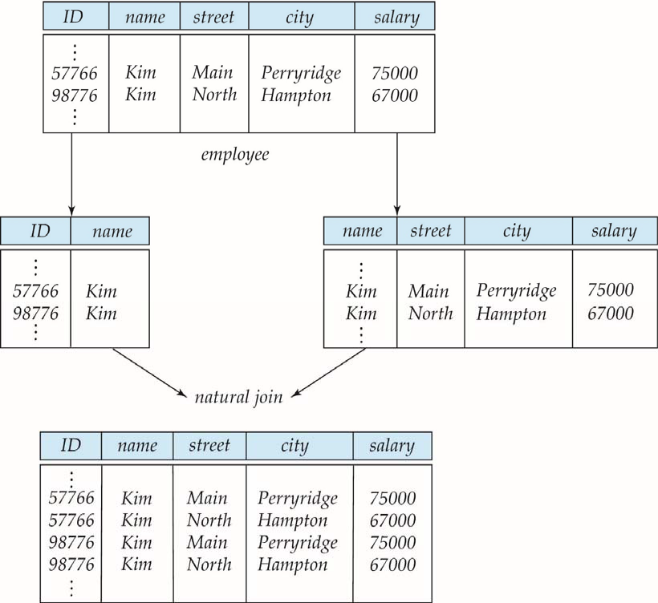
A Lossy Decomposition
PPD
SWAYAM: NPTEL-NOC MOOCs Instructor: Prof. P P Das, IIT Kharagpur. Jan-Apr, 2018
Duplicate names cause the problem here.

Slide 11
Example of Lossless-Join Decomposition
SWAYAM: NPTEL-NOC MOOCs Instructor: Prof. P P Das, IIT Kharagpur. Jan-Apr, 2018
Lossless join decomposition
Decomposition of R = (A, B, C)
R₁ = (A, B)
R₂ = (B, C)
A B C
A B
B C
α 1 A
β 2 B
α 1
β 2
A
B
r
∏_{A,B}(r)
∏_{B,C}(r)
∏_{A} (r) ∏_{B} (r)
A B C
α 1 A
β 2 B

Slide 12
PPD
Features of Good Relational Design
Atomic Domains and First Normal Form
Functional Dependencies
SWAYAM: NPTEL-NOC MOOCs Instructor: Prof. P P Das, IIT Kharagpur. Jan-Apr, 2018
ATOMIC DOMAINS AND FIRST NORMAL FORM

Slide 13
First Normal Form (1NF)
PPD
SWAYAM: NPTEL-NOC MOOCs Instructor: Prof. P P Das, IIT Kharagpur. Jan-Apr, 2018
Domain is atomic if its elements are considered to be indivisible units
Examples of non-atomic domains:
Set of names, composite attributes
Identification numbers like CS101 that can be broken up into parts
A relational schema R is in first normal form if
the domains of all attributes of R are atomic
the value of each attribute contains only a single value from that domain
Non-atomic values complicate storage and encourage redundant (repeated) storage of data
Example: Set of accounts stored with each customer, and set of owners stored with each account
We assume all relations are in first normal form

Slide 14
First Normal Form (Cont’d)
SWAYAM: NPTEL-NOC MOOCs Instructor: Prof. P P Das, IIT Kharagpur. Jan-Apr, 2018
Atomicity is actually a property of how the elements of the domain are used
Example: Strings would normally be considered indivisible
Suppose that students are given roll numbers which are strings of the form CS0012 or EE1127
If the first two characters are extracted to find the department, the domain of roll numbers is not atomic
Doing so is a bad idea: leads to encoding of information in application program rather than in the database

Slide 15
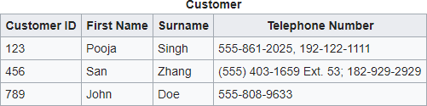
First Normal Form (Cont’d)
PPD
SWAYAM: NPTEL-NOC MOOCs Instructor: Prof. P P Das, IIT Kharagpur. Jan-Apr, 2018
The following is not in 1NF
A telephone number is composite
Telephone number is multi-valued
Source: https://en.wikipedia.org/wiki/First_normal_form

Slide 16
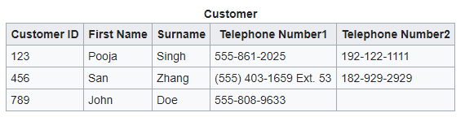
First Normal Form (Cont’d)
PPD
SWAYAM: NPTEL-NOC MOOCs Instructor: Prof. P P Das, IIT Kharagpur. Jan-Apr, 2018
Consider:
Is in 1NF if telephone number is not considered composite
However, conceptually, we have two attributes for the same concept
Arbitrary and meaningless ordering of attributes
How to search telephone numbers
Why only two numbers?
Source: https://en.wikipedia.org/wiki/First_normal_form

Slide 17
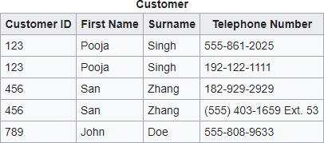
First Normal Form (Cont’d)
PPD
SWAYAM: NPTEL-NOC MOOCs Instructor: Prof. P P Das, IIT Kharagpur. Jan-Apr, 2018
Is the following in 1NF?
Duplicated information
ID is no more the key. Key is (ID, Telephone Number)
Source: https://en.wikipedia.org/wiki/First_normal_form

Slide 18
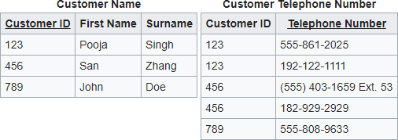
First Normal Form (Cont’d)
PPD
SWAYAM: NPTEL-NOC MOOCs Instructor: Prof. P P Das, IIT Kharagpur. Jan-Apr, 2018
Better to have 2 relations:
One-to-Many relationship between parent and child relations
Incidentally, satisfies 2NF and 3NF
Source: https://en.wikipedia.org/wiki/First_normal_form

Slide 19
PPD
Features of Good Relational Design
Atomic Domains and First Normal Form
Functional Dependencies
SWAYAM: NPTEL-NOC MOOCs Instructor: Prof. P P Das, IIT Kharagpur. Jan-Apr, 2018
FUNCTIONAL DEPENDENCIES

Slide 20
Goal — Devise a Theory for the Following
SWAYAM: NPTEL-NOC MOOCs Instructor: Prof. P P Das, IIT Kharagpur. Jan-Apr, 2018
Decide whether a particular relation R is in “good” form.
In the case that a relation R is not in “good” form, decompose it into a set of relations {R₁, R₂, ..., R_{n}} such that
each relation is in good form
the decomposition is a lossless-join decomposition
Our theory is based on:
functional dependencies
multivalued dependencies

Slide 21
Functional Dependencies
SWAYAM: NPTEL-NOC MOOCs Instructor: Prof. P P Das, IIT Kharagpur. Jan-Apr, 2018
Constraints on the set of legal relations
Require that the value for a certain set of attributes determines uniquely the value for another set of attributes
A functional dependency is a generalization of the notion of a key

Slide 22
Functional Dependencies (Cont.)
SWAYAM: NPTEL-NOC MOOCs Instructor: Prof. P P Das, IIT Kharagpur. Jan-Apr, 2018
Let R be a relation schema
α ⊆ R and β ⊆ R
The functional dependency
α → β
holds on R if and only if for any legal relations r(R), whenever any two tuples t₁ and t₂ of r agree on the attributes α, they also agree on the attributes β. That is,
t₁[α] = t₂ [α] ⇒ t₁[β ] = t₂ [β ]
Example: Consider r(A,B ) with the following instance of r.
1 | 4
1 | 5
3 | 7
On this instance, A → B does NOT hold, but B → A does hold.

Slide 23
Functional Dependencies (Cont.)
SWAYAM: NPTEL-NOC MOOCs Instructor: Prof. P P Das, IIT Kharagpur. Jan-Apr, 2018
K is a superkey for relation schema R if and only if K → R
K is a candidate key for R if and only if
K → R, and
for no α ⊂ K, α → R
Functional dependencies allow us to express constraints that cannot be expressed using superkeys. Consider the schema:
inst_dept (ID, name, salary, dept_name, building, budget ). We expect these functional dependencies to hold:
dept_name→ building
and ID → building
but would not expect the following to hold:
dept_name → salary

Slide 24
Use of Functional Dependencies
SWAYAM: NPTEL-NOC MOOCs Instructor: Prof. P P Das, IIT Kharagpur. Jan-Apr, 2018
We use functional dependencies to:
test relations to see if they are legal under a given set of functional dependencies.
If a relation r is legal under a set F of functional dependencies, we say that r satisfies F
specify constraints on the set of legal relations
We say that F holds on R if all legal relations on R satisfy the set of functional dependencies F
Note: A specific instance of a relation schema may satisfy a functional dependency even if the functional dependency does not hold on all legal instances
For example, a specific instance of instructor may, by chance, satisfy
name → ID

Slide 25
Functional Dependencies (Cont.)
SWAYAM: NPTEL-NOC MOOCs Instructor: Prof. P P Das, IIT Kharagpur. Jan-Apr, 2018
A functional dependency is trivial if it is satisfied by all instances of a relation
Example:
ID, name → ID
name → name
In general, α → β is trivial if β ⊆ α

Slide 26
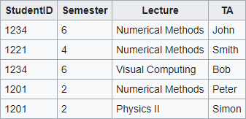
Functional Dependencies (Cont.)
PPD
SWAYAM: NPTEL-NOC MOOCs Instructor: Prof. P P Das, IIT Kharagpur. Jan-Apr, 2018
Functional dependencies are:
StudentID → Semester
{StudentID, Lecture} → TA
{StudentID, Lecture} → {TA, Semester}

Slide 27
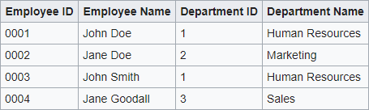
Functional Dependencies (Cont.)
PPD
SWAYAM: NPTEL-NOC MOOCs Instructor: Prof. P P Das, IIT Kharagpur. Jan-Apr, 2018
Functional dependencies are:
Employee ID → Employee Name
Employee ID → Department ID
Department ID → Department Name

Slide 28
Closure of a Set of Functional Dependencies
SWAYAM: NPTEL-NOC MOOCs Instructor: Prof. P P Das, IIT Kharagpur. Jan-Apr, 2018
Given a set F of functional dependencies, there are certain other functional dependencies that are logically implied by F
For example: If A → B and B → C, then we can infer that A → C
The set of all functional dependencies logically implied by F is the closure of F
We denote the closure of F by F⁺
F⁺ is a superset of F
F = {A → B, B → C}
F⁺ = {A → B, B → C, A → C}

Slide 29
Module Summary
SWAYAM: NPTEL-NOC MOOCs Instructor: Prof. P P Das, IIT Kharagpur. Jan-Apr, 2018
Identified the features of good relational design
Familiarized with the First Normal Form
Introduced the notion of Functional Dependencies

Slide 30

Instructor and TAs
PPD
SWAYAM: NPTEL-NOC MOOCs Instructor: Prof. P P Das, IIT Kharagpur. Jan-Apr, 2018
Name | Mail | Mobile
Partha Pratim Das, Instructor | ppd@cse.iitkgp.ernet.in | 9830030880
Srijoni Majumdar, TA | majumdarsrijoni@gmail.com | 9674474267
Himadri B G S Bhuyan, TA | himadribhuyan@gmail.com | 9438911655
Gurunath Reddy M | mgurunathreddy@gmail.com | 9434137638
Slides used in this presentation are borrowed from http://db-book.com/ with kind permission of the authors.
Edited and new slides are marked with “PPD”.

Slide 31
Database Management Systems
Module 17: Relational Database Design/2
SWAYAM: NPTEL-NOC MOOCs Instructor: Prof. P P Das, IIT Kharagpur. Jan-Apr, 2018
Partha Pratim Das
Department of Computer Science and Engineering Indian Institute of Technology, Kharagpur
ppd@cse.iitkgp.ernet.in
Srijoni Majumdar Himadri B G S Bhuyan Gurunath Reddy M
Database System Concepts, 6th Ed.
©Silberschatz, Korth and Sudarshan www.db-book.com

Slide 32
Module Recap
PPD
SWAYAM: NPTEL-NOC MOOCs Instructor: Prof. P P Das, IIT Kharagpur. Jan-Apr, 2018
Features of Good Relational Design
Atomic Domains and First Normal Form
Functional Dependencies

Slide 33
Module Objectives
PPD
SWAYAM: NPTEL-NOC MOOCs Instructor: Prof. P P Das, IIT Kharagpur. Jan-Apr, 2018
To understand how a schema can be decomposed for a ‘good’ design using functional dependencies
To introduce the theory of functional dependencies

Slide 34
Module Outline
PPD
SWAYAM: NPTEL-NOC MOOCs Instructor: Prof. P P Das, IIT Kharagpur. Jan-Apr, 2018
Decomposition Using Functional Dependencies
Functional Dependency Theory

Slide 35
PPD
Decomposition Using Functional Dependencies
Functional Dependency Theory
SWAYAM: NPTEL-NOC MOOCs Instructor: Prof. P P Das, IIT Kharagpur. Jan-Apr, 2018
DECOMPOSITION USING FUNCTIONAL DEPENDENCIES

Slide 36
Boyce-Codd Normal Form
SWAYAM: NPTEL-NOC MOOCs Instructor: Prof. P P Das, IIT Kharagpur. Jan-Apr, 2018
A relation schema R is in BCNF with respect to a set F of functional dependencies if for all functional dependencies in F⁺ of the form
α → β
where α ⊆ R and β ⊆ R, at least one of the following holds:
α → β is trivial (i.e., β ⊆ α)
α is a superkey for R
Example schema not in BCNF:
instr_dept (ID, name, salary, dept_name, building, budget )
because dept_name→ building, budget holds on instr_dept, but dept_name is not a superkey

Slide 37
Decomposing a Schema into BCNF
SWAYAM: NPTEL-NOC MOOCs Instructor: Prof. P P Das, IIT Kharagpur. Jan-Apr, 2018
Suppose we have a schema R and a non-trivial dependency α →β
causes a violation of BCNF
We decompose R into:
(α U β )
( R - ( β - α ) )
In our example,
α = dept_name
β = building, budget
dept_name → building, budget inst_dept is replaced by
(α U β ) = ( dept_name, building, budget )
dept_name → building, budget
( R - ( β - α ) ) = ( ID, name, salary, dept_name )
ID → name, salary, dept_name

Slide 38
BCNF and Dependency Preservation
SWAYAM: NPTEL-NOC MOOCs Instructor: Prof. P P Das, IIT Kharagpur. Jan-Apr, 2018
Constraints, including functional dependencies, are costly to check in practice unless they pertain to only one relation
If it is sufficient to test only those dependencies on each individual relation of a decomposition in order to ensure that all functional dependencies hold, then that decomposition is dependency preserving.
Because it is not always possible to achieve both BCNF and dependency preservation, we consider a weaker normal form, known as third normal form.

Slide 39
Third Normal Form
SWAYAM: NPTEL-NOC MOOCs Instructor: Prof. P P Das, IIT Kharagpur. Jan-Apr, 2018
A relation schema R is in third normal form (3NF) if for all:
α → β in F⁺
at least one of the following holds:
α → β is trivial (i.e., β ⊆ α)
α is a superkey for R
Each attribute A in β – α is contained in a candidate key for R
(NOTE: each attribute may be in a different candidate key)
If a relation is in BCNF it is in 3NF (since in BCNF one of the first two conditions above must hold)
Third condition is a minimal relaxation of BCNF to ensure dependency preservation (will see why later)

Slide 40
Goals of Normalization
SWAYAM: NPTEL-NOC MOOCs Instructor: Prof. P P Das, IIT Kharagpur. Jan-Apr, 2018
Let R be a relation scheme with a set F of functional dependencies
Decide whether a relation scheme R is in “good” form
In the case that a relation scheme R is not in “good” form, decompose it into a set of relation scheme {R₁, R₂, ..., R_{n}} such that
each relation scheme is in good form
the decomposition is a lossless-join decomposition
Preferably, the decomposition should be dependency preserving

Slide 41
How good is BCNF?
SWAYAM: NPTEL-NOC MOOCs Instructor: Prof. P P Das, IIT Kharagpur. Jan-Apr, 2018
There are database schemas in BCNF that do not seem to be sufficiently normalized
Consider a relation
inst_info (ID, child_name, phone)
where an instructor may have more than one phone and can have multiple children
ID
99999
99999
99999
99999
child_name
phone
512-555-1234
512-555-4321
512-555-1234
512-555-4321
David David William Willian
inst_info

Slide 42
How good is BCNF? (Cont.)
SWAYAM: NPTEL-NOC MOOCs Instructor: Prof. P P Das, IIT Kharagpur. Jan-Apr, 2018
There are no non-trivial functional dependencies and therefore the relation is in BCNF
Insertion anomalies – i.e., if we add a phone 981-992-3443 to 99999, we need to add two tuples
(99999, David, 981-992-3443)
(99999, William, 981-992-3443)

Slide 43
How good is BCNF? (Cont.)
SWAYAM: NPTEL-NOC MOOCs Instructor: Prof. P P Das, IIT Kharagpur. Jan-Apr, 2018
Therefore, it is better to decompose inst_info into:
ID
child_name
inst_child
99999
99999
99999
99999
David David William Willian
ID
phone
inst_phone
99999
99999
99999
99999
512-555-1234
512-555-4321
512-555-1234
512-555-4321
This suggests the need for higher normal forms, such as Fourth Normal Form (4NF)

Slide 44
PPD
Decomposition Using Functional Dependencies
Functional Dependency Theory
SWAYAM: NPTEL-NOC MOOCs Instructor: Prof. P P Das, IIT Kharagpur. Jan-Apr, 2018
FUNCTIONAL DEPENDENCY THEORY

Slide 45
Functional-Dependency Theory
SWAYAM: NPTEL-NOC MOOCs Instructor: Prof. P P Das, IIT Kharagpur. Jan-Apr, 2018
We now consider the formal theory that tells us which functional dependencies are implied logically by a given set of functional dependencies
We then develop algorithms to generate lossless decompositions into BCNF and 3NF
We then develop algorithms to test if a decomposition is dependency-preserving

Slide 46
Closure of a Set of Functional Dependencies
SWAYAM: NPTEL-NOC MOOCs Instructor: Prof. P P Das, IIT Kharagpur. Jan-Apr, 2018
Given a set F set of functional dependencies, there are certain other functional dependencies that are logically implied by F
For e.g.: If A → B and B → C, then we can infer that A → C
The set of all functional dependencies logically implied by F is the
closure of F
We denote the closure of F by F⁺

Slide 47
Closure of a Set of Functional Dependencies
SWAYAM: NPTEL-NOC MOOCs Instructor: Prof. P P Das, IIT Kharagpur. Jan-Apr, 2018
We can find F^{+,} the closure of F, by repeatedly applying Armstrong’s Axioms:
if β ⊆ α, then α → β
if α → β, then γ α → γ β
if α → β, and β → γ, then α → γ
These rules are
(reflexivity) (augmentation) (transitivity)
sound (generate only functional dependencies that actually hold), and
complete (generate all functional dependencies that hold)

Slide 48
Example
SWAYAM: NPTEL-NOC MOOCs Instructor: Prof. P P Das, IIT Kharagpur. Jan-Apr, 2018
R = (A, B, C, G, H, I) F = { A → B
A → C CG → H CG → I
B → H}
Some members of F⁺
A → H
by transitivity from A → B and B → H
AG → I
by augmenting A → C with G, to get AG → CG and then transitivity with CG → I
CG → HI
by augmenting CG → I to infer CG → CGI, and augmenting of CG → H to infer
CGI→ HI, and then transitivity

Slide 49
Procedure for Computing F⁺
SWAYAM: NPTEL-NOC MOOCs Instructor: Prof. P P Das, IIT Kharagpur. Jan-Apr, 2018
To compute the closure of a set of functional dependencies F:
F ⁺ = F
repeat
for each functional dependency f in F⁺
apply reflexivity and augmentation rules on f
add the resulting functional dependencies to F ⁺
for each pair of functional dependencies f₁and f₂ in F ⁺
if f₁ and f₂ can be combined using transitivity
then add the resulting functional dependency to F ⁺
until F ⁺ does not change any further
NOTE: We shall see an alternative procedure for this task later

Slide 50
Closure of Functional Dependencies (Cont.)
SWAYAM: NPTEL-NOC MOOCs Instructor: Prof. P P Das, IIT Kharagpur. Jan-Apr, 2018
Additional rules:
If α → β holds and α → γ holds, then α → β γ holds (union)
If α → β γ holds, then α → β holds and α → γ holds (decomposition)
If α → β holds and γ β → δ holds, then α γ → δ holds (pseudotransitivity)
The above rules can be inferred from Armstrong’s axioms

Slide 51
Closure of Attribute Sets
SWAYAM: NPTEL-NOC MOOCs Instructor: Prof. P P Das, IIT Kharagpur. Jan-Apr, 2018
Given a set of attributes α, define the closure of α under F (denoted by α⁺) as the set of attributes that are functionally determined by α under F
Algorithm to compute α⁺, the closure of α under F result := α;
while (changes to result) do for each β → γ in F do
begin
if β ⊆ result then result := result ∪ γ
end

Slide 52
Example of Attribute Set Closure
R = (A, B, C, G, H, I)
F = {A → B
A → C CG → H CG → I B → H}
(AG)⁺
result = AG
result = ABCG (A → C and A → B)
result = ABCGH (CG → H and CG ⊆ AGBC)
result = ABCGHI (CG → I and CG ⊆ AGBCH)
Is AG a candidate key?
Is AG a super key?
Does AG → R? == Is (AG)⁺ ⊇ R
Is any subset of AG a superkey?
Does A → R? == Is (A)⁺ ⊇ R
Does G → R? == Is (G)⁺ ⊇ R
SWAYAM: NPTEL-NOC MOOCs Instructor: Prof. P P Das, IIT Kharagpur. Jan-Apr, 2018

Slide 53
Uses of Attribute Closure
SWAYAM: NPTEL-NOC MOOCs Instructor: Prof. P P Das, IIT Kharagpur. Jan-Apr, 2018
There are several uses of the attribute closure algorithm:
Testing for superkey:
To test if α is a superkey, we compute α^{+,} and check if α⁺ contains all attributes of R.
Testing functional dependencies
To check if a functional dependency α → β holds (or, in other words, is in F⁺), just check if β
⊆ α⁺.
That is, we compute α⁺ by using attribute closure, and then check if it contains β.
Is a simple and cheap test, and very useful
Computing closure of F
For each γ ⊆ R, we find the closure γ⁺, and for each S ⊆ γ⁺, we output a functional dependency γ → S.

Slide 54
Module Summary
SWAYAM: NPTEL-NOC MOOCs Instructor: Prof. P P Das, IIT Kharagpur. Jan-Apr, 2018
Discussed issues in ‘good’ design in the context of functional dependencies
Introduced the theory of functional dependencies

Slide 55
Instructor and TAs
PPD
SWAYAM: NPTEL-NOC MOOCs Instructor: Prof. P P Das, IIT Kharagpur. Jan-Apr, 2018
Name | Mail | Mobile
Partha Pratim Das, Instructor | ppd@cse.iitkgp.ernet.in | 9830030880
Srijoni Majumdar, TA | majumdarsrijoni@gmail.com | 9674474267
Himadri B G S Bhuyan, TA | himadribhuyan@gmail.com | 9438911655
Gurunath Reddy M | mgurunathreddy@gmail.com | 9434137638
Slides used in this presentation are borrowed from http://db-book.com/ with kind permission of the authors.
Edited and new slides are marked with “PPD”.

